Slide 1
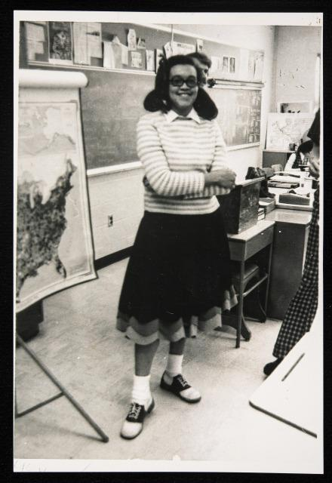
“We didn’t learn all of our lessons through serious experiences and endeavors. Some of the best lessons came as by-products of fun-filled activities. Those are some of my most pleasant Preston, [Oklahoma] memories. Given the hard economic times in Oklahoma when I was growing up, it’s a wonder that we ever had any fun, but we did. That is what so many non-minorities fail to understand about minorities, that despite the well-documented hardships endured by minorities from the beginning of their history in this country, they have managed to cope, survive, and emerge intact physically and emotionally.”
Miz Lucy’s Cookies

Slide 2
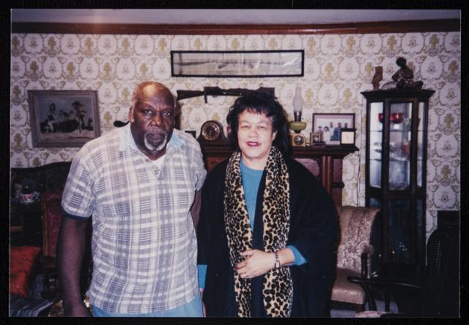
Norman and Eddie Faye Gates at home, Tulsa 2000
“Of all the links in the support system, the family link is the most vital, and it was my family that was the most influential factor in paving the way for my success. My family loved and cherished me, had faith in me, and firmly convinced me that with my innate intelligence, my energy and enthusiasm, I could, if I worked hard enough, achieve anything that I set my mind to; and I did!” --Miz Lucy’s Cookies

Slide 3
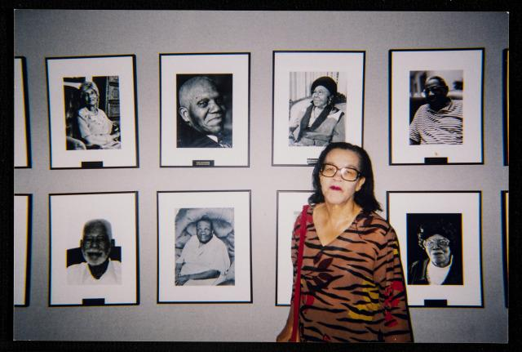
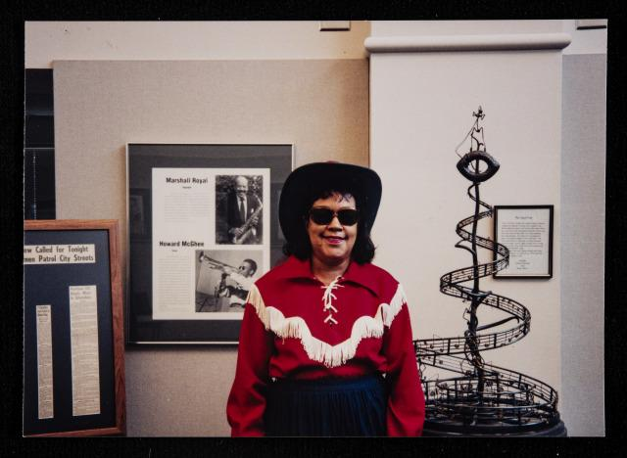
“People who know me take my zealous sharing of information in stride and do not think negatively of me because of my constant snapping of photographs, asking for interviews, clipping of articles, making tons of scrapbooks, and freely giving advice. They know that is just me being me!” --Riot on Greenwood

Slide 4
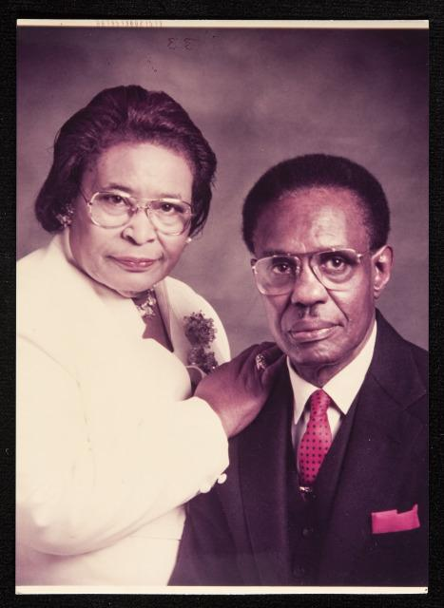
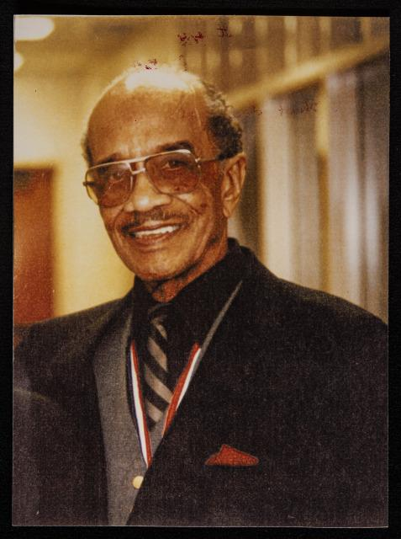
Mr. Clarence Love at his induction into the Oklahoma Jazz Hall of Fame, Tulsa, OK, June 1990.
Hugh Hollins, retired barber, with his late wife Naomi Hollins who was also a barber. Hugh Hollins--7 decades of barbering. Gave his first haircut, for a nickel, when he was 8 years old.

Slide 5
Art Buckner
San Francisco, California, b. August 28, 1909, d. August 2001
“On June 1, 1921, when the riot was getting worse, I was too young to know the significance of what I was witnessing. I was just a curious young boy. [...] But I went into the yard to get a better look. A bullet nearly hit me--it just whizzed right over my head and hit a horse. [...] We ran down Santa Fe railroad tracks. Some people hadn’t had time to put on shoes, and the gravel was tearing up their feet.”

Slide 6
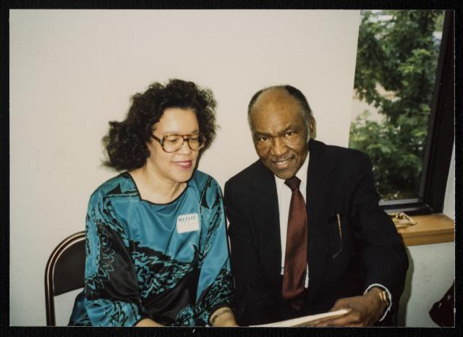
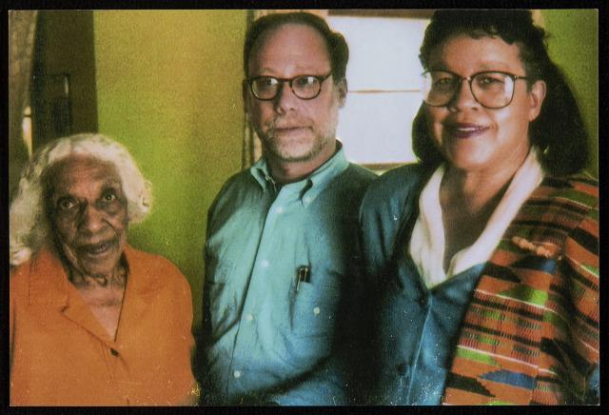
(Left to Right): Veneice Dunn Sims, 92, riot survivor; Michael Rosenbaum, 60 Minutes II Senior Producer; Eddie Faye Gates, riot commissioner
November 1999
Eddie Faye Gates and Arthur Fletcher, Director, U.S. Commission on Civil Rights (appointed by President George Bush)
Human Rights Reception, May 31, 1990

Slide 7
Rosella Carter
Kansas City, Missouri, b. June 20, 1900
“I had my seven-month-old son, James Dale, in my arms. My husband was running down the middle of the street when he got shot in the stomach. The bullet hit his belt buckle and ricocheted. It caused a split right in his stomach. When he was found, the people who found him thought he could not possibly survive that wound, as his intestines were actually hanging outside! But he did live, though he suffered from that wound the rest of his life--locked bowels, severe pains, cramps--he died in December of 1935. His death was directly connected to that bullet wound he got during the riot.”

Slide 8
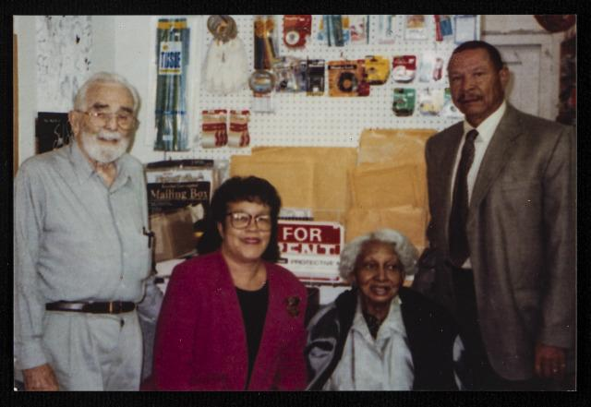
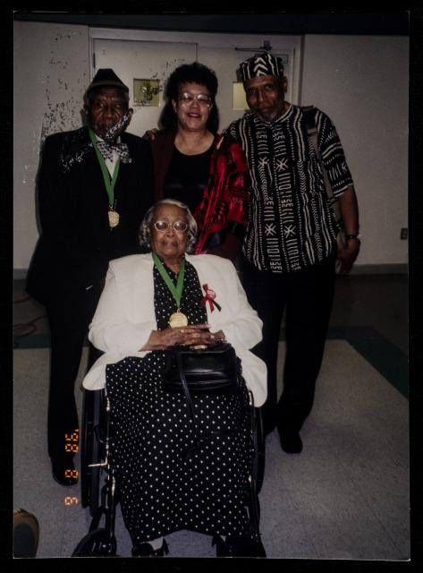
Word out! Steve’s Bookstore, 1996
Seated: Genevieve Tillman Jackson, riot survivor. Standing L-R: Otis G. Clark, riot survivor, Eddie Faye Gates, Useni Perkins at premier of Perkins’ play, “If We Must Die,” Greenwood Cultural Center, Tulsa, April 27, 2001.

Slide 9
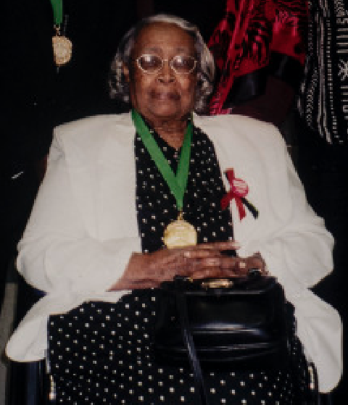
Genevieve Elizabeth Tillman Jackson
Tulsa, Oklahoma, b. June 29, 1915
“Early that morning of June 1, 1921, I was out in the yard and I was just flitting around everywhere, looking at everything. What I saw puzzled me. I saw smoke and flames in the sky over the Greenwood area, and I saw what I thought were little black birds dropping out of the sky. But those were no little birds; what was falling from the sky over the Negro district, as it was called in those days, were bullets, and devices to set fires, and debris of all kinds. [...] Later on that day, I saw something else that fascinated me. I saw a truck load of dead bodies being carried somewhere. I was spellbound looking at those bodies--bodies that looked like they had just haphazardly been thrown onto that truck, with arms and legs just dangling.”

Slide 10
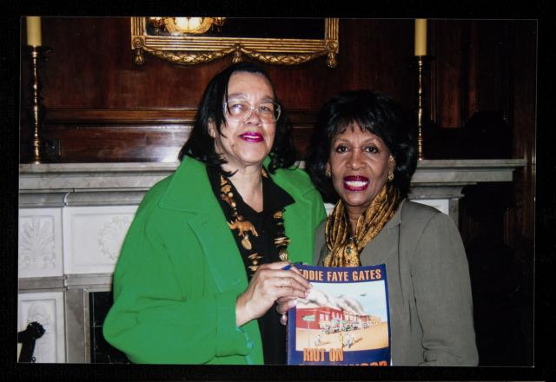
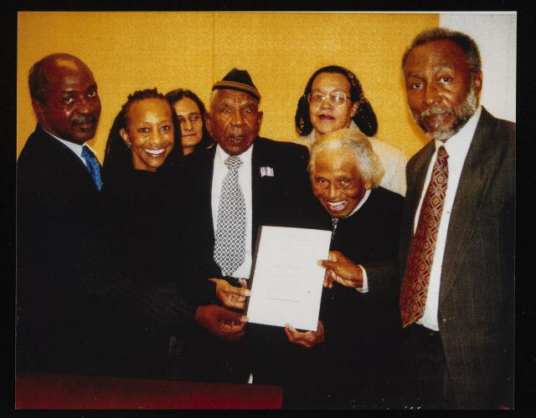
L-R (1) Dr. Charles Ogletree, (4) Otis Greenville, riot survivor, (5) Dr. Olivia Hosker, riot survivor, (Back) Eddie Faye Gates, OK Commissioner to Study TRR 1921
Organization of American States D.C. Meeting, 2007
Eddie Faye Gates with Maxine Waters, United States Representative

Slide 11
Muriel Mignon Lilly Cabell
Los Angeles, California, b. December 29, 1913
“Our house was the third house burned during the riot. We lost everything, and we had some nice things including a Kimball piano, photographic equipment, tools, furnishings, one Ford sedan car, one Ford coupe car, and miscellaneous things. We were pitiful after that riot. All our possessions, hopes, and dreams were gone.”

Slide 12
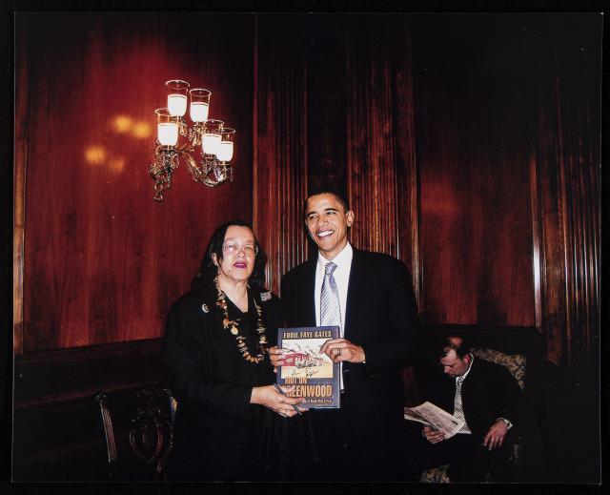
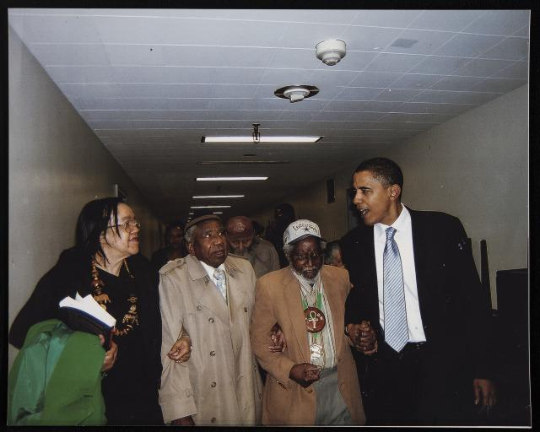
L to R: Eddie Faye Gates, Otis Greenville Clark, riot survivor, Wess Young, riot survivor, Barack Obama, United States Senator
Washington D.C., 2005
Eddie Faye Gates with United States Senator Barack Obama
Washington D.C., 2005

Slide 13
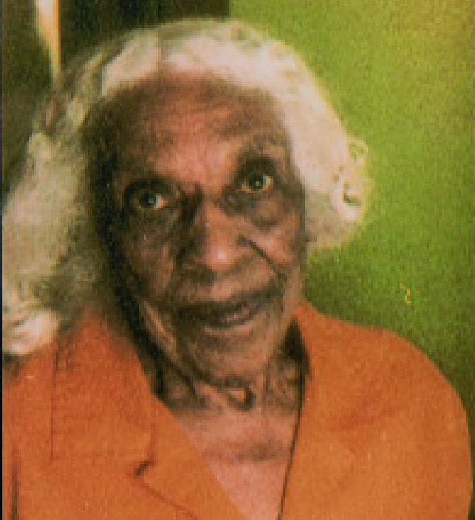
Veneice Dunn Sims
Tulsa, Oklahoma, b. January 21, 1905
“That’s what happened. Some Blacks walked to safe places in Oklahoma, up to sixty miles by foot. Others hopped freight trains and went north, east, or west. Others were never heard of again and are presumed to have died in the riot and to have been hastily buried who knows where. I’ve heard they were buried in mine pits, or dumped in the Arkansas River, or incinerated at the park in Sand Springs. I don’t know where the bodies were buried. But I do know that we never saw some of our friends and neighbors again. Neither did they communicate with anyone again. I believe in my heart that they were killed in the riot.”

Slide 14
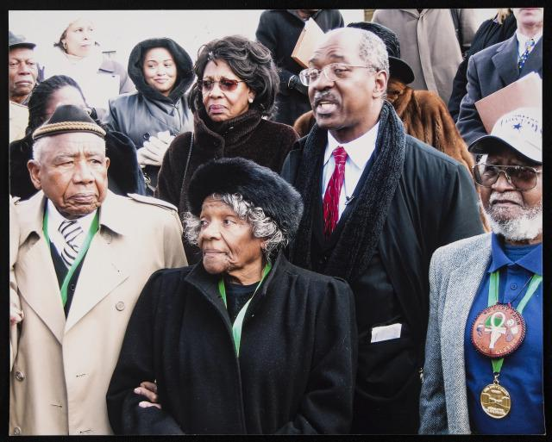
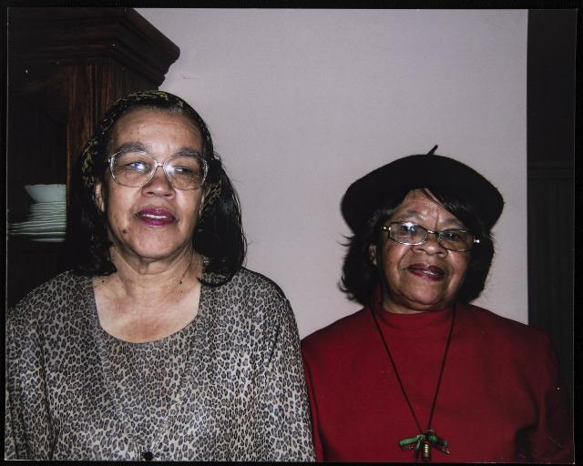
Eddie Faye Gates with Jean Ficklin, long time California activist and youth leader, Newark, CA.
(Top Center) Maxine Waters, U.S. Congresswoman; (Bottom) Dr. Charles Ogletree, lead attorney, TRR 1921 lawsuit; (L to R) TRR 1921 Survivors, Otis Greenville Clark, Thelma Knight, Wess Young
U.S. Supreme Court
Washington D.C., 2005

Slide 15
James Durant
Detroit, Michigan, b. January 27, 1915
“Although I was only six years old at the time, I remember the riot as if it were yesterday. [...] We could hear bullets hitting against the house. It was an awful experience that I will never forget. Our home and everything we owned was burned to the ground. [...] They always said the elevator incident was a staged event. The leaders of Tulsa wanted that area to expand into, and when Blacks wouldn’t sell it to them, they had to have an excuse for the mobsters to go in and take it for them.”

Slide 16
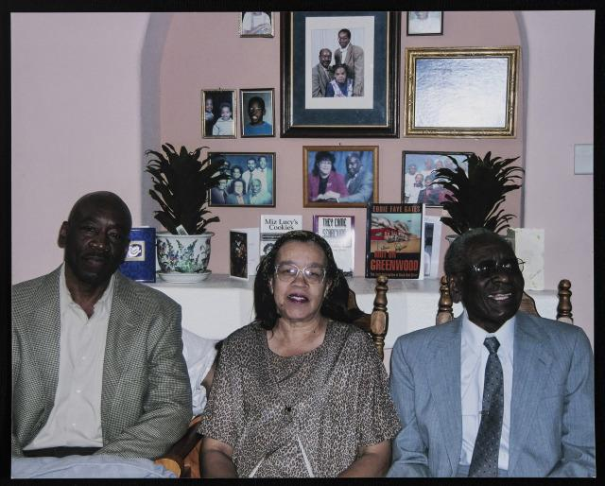
L-R Homasi White, son of TRR 1921 survivor; Eddie Faye Gates; Cecil White, of Berkeley, CA.
Union City, 2005

Slide 17
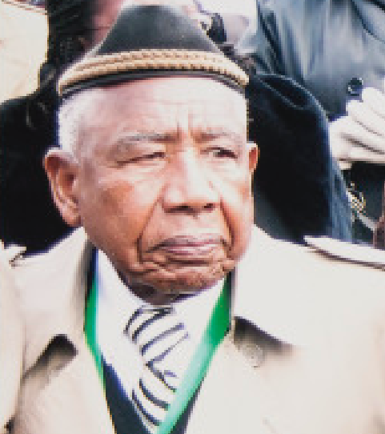
Otis G. Clark
Tulsa, Oklahoma, b.February 13, 1903
“The upper stories of some of those white industrial buildings were used by white snipers to kill Blacks who were defending Greenwood. During the riot, I got caught in the middle of a gun battle. Some White mobsters were holed up in the upper floor of the Ray Rhee Flour Mill on East Archer, and they were just gunning down Black people, just picking them off like they were swatting flies.”

Slide 18
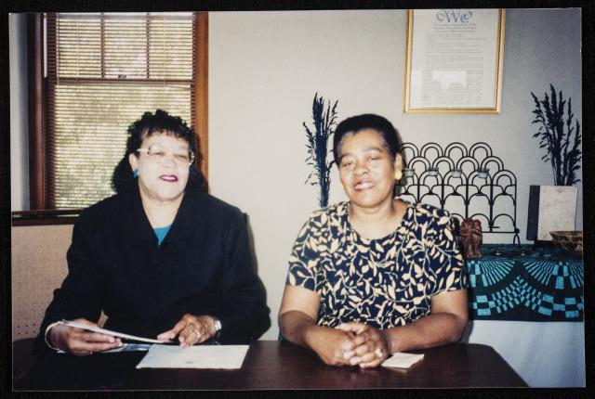
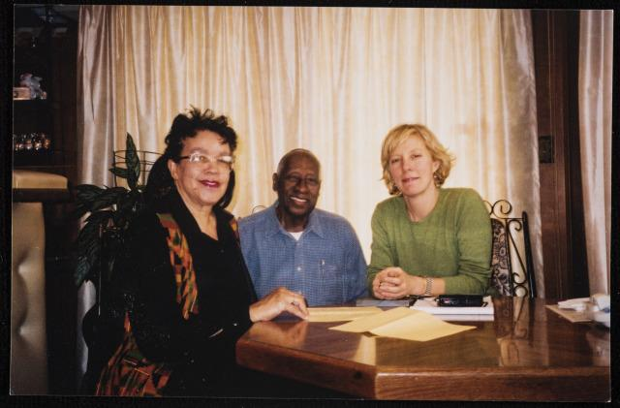
People Magazine visit to Tulsa, 2002
Eddie Faye Gates and Dr. Vivian Clark Adams, TRR program, May 2002

Slide 19
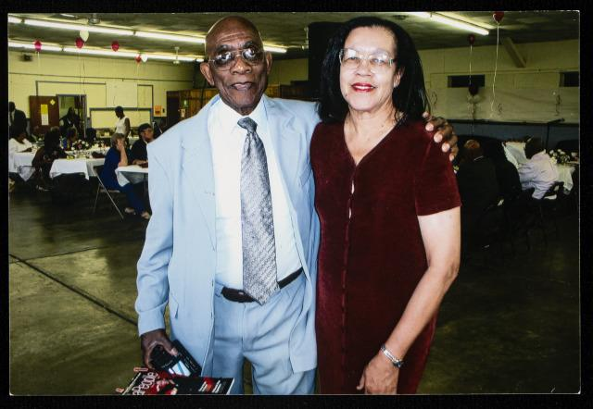
William Harold Woods
Portland, Oregon, b. May 18, 1921
“During the riot, the Woods and their children joined the crowd of terrified Blacks running for their lives down Greenwood. They were captured by militia and put in a detention camp. When his dad was let out, he moved the family to Coffeyville, Kansas. He just couldn’t bear to remain in Tulsa after that riot.
William Harold Woods & Eddie Faye Gates, 2006

Slide 20
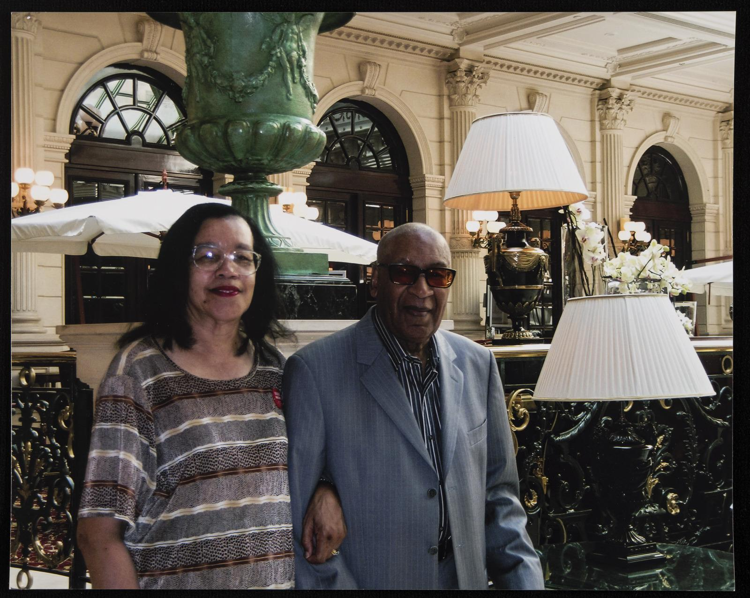
Eddie Faye Gates and Harold (Hal) “Cornbread” Singer
Paris, France

Slide 21
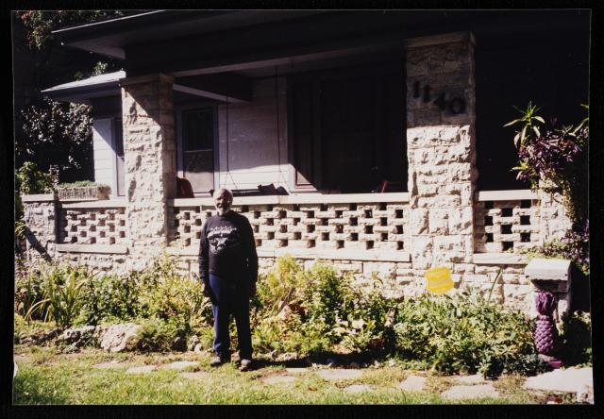
Wess Young
Tulsa, Oklahoma, b. February 20, 1917
“They (whites) still wanted the Greenwood area so they could expand northward. But Blacks were determined to rebuild. There was new prosperity in the Greenwood area. In fact, Tulsa had recovered so well that it hosted the National Negro Business League Convention in 1926!

Slide 22
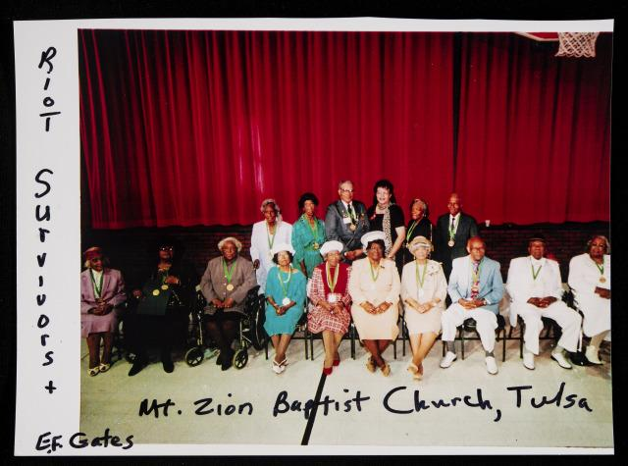
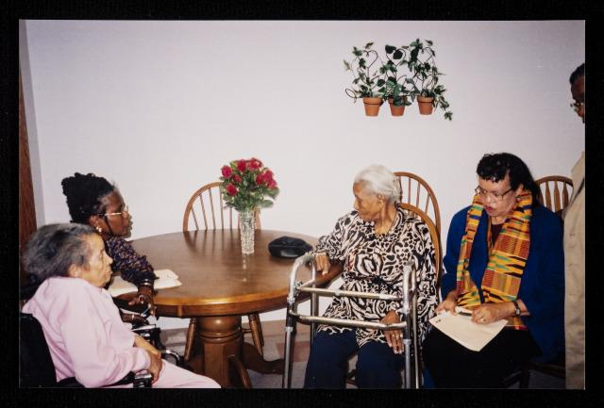
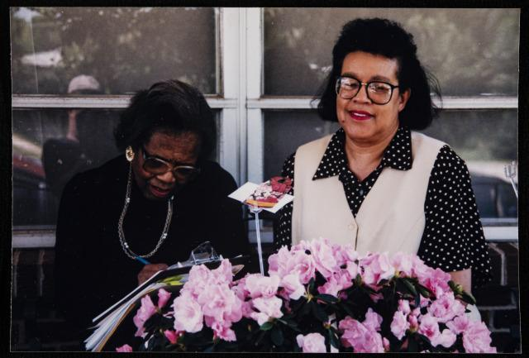
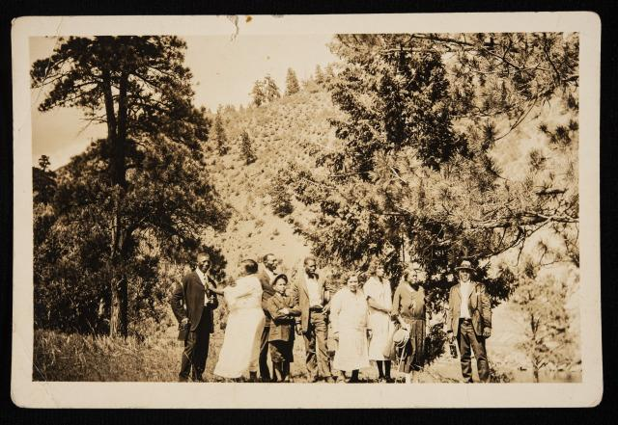
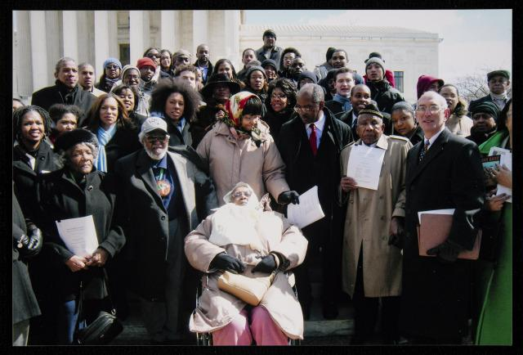
L-R Ernestine Gibbs, survivor, CA., NCOBRA lawyer Adjoa Aiyetoro, Essie Beck, survivor, Eddie Faye Gates (2-9-2013)
Elizabeth Chappelle and Eddie Faye Gates

Slide 23
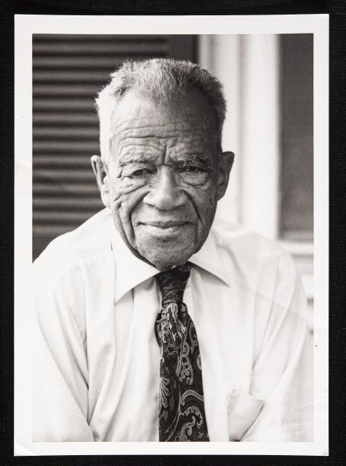
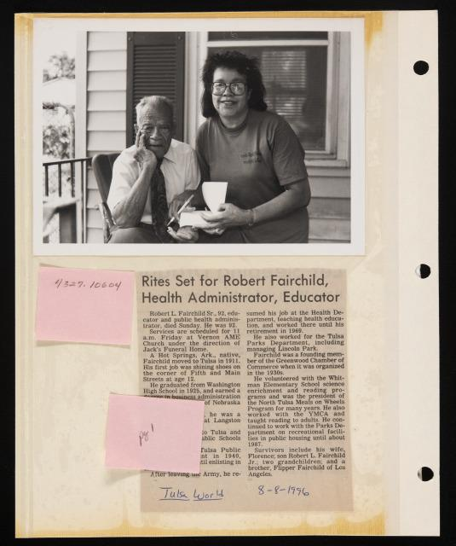
Robert Fairchild (1996)
Survivor, Tulsa Race Riot of 1921

Slide 24
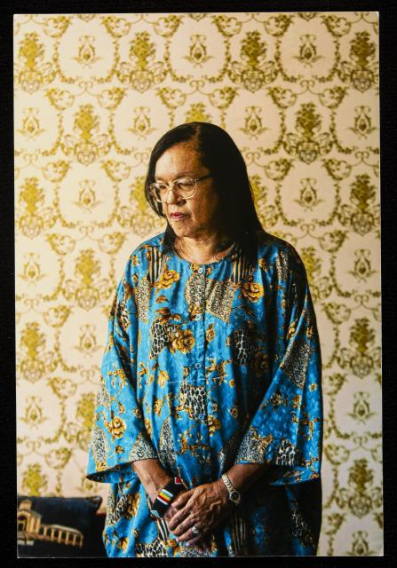
“But, looking at my life slate with hindsight, I believe that it is a pretty clear, unblemished slate for the most part.”
Miz Lucy’s Cookies

